Slide 1
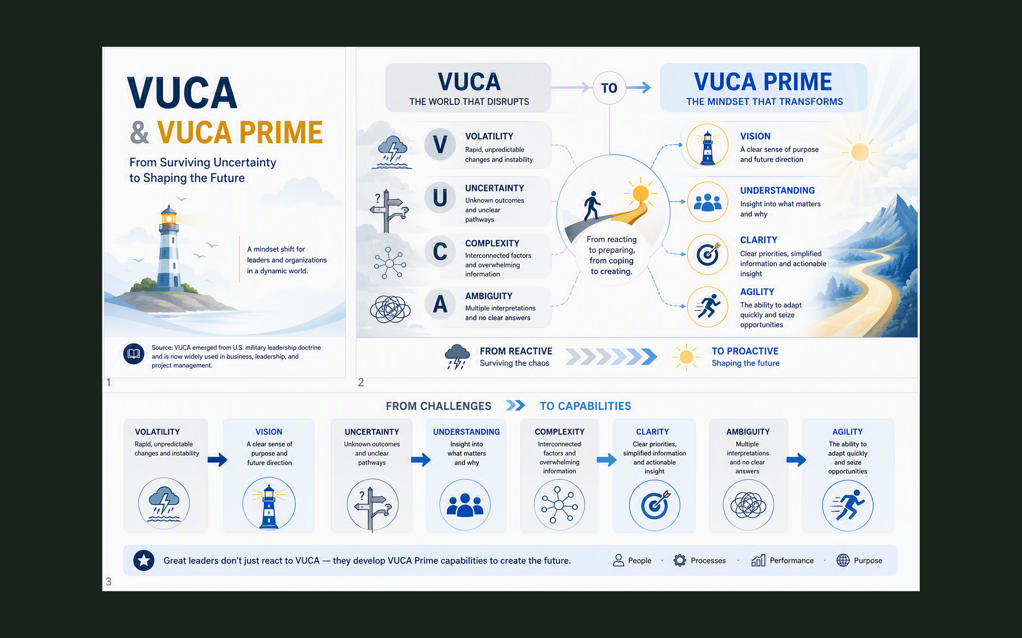
We Live in the VUCA World

Slide 2
Course Outline (1 of 2)
Chapter 1 Getting Started with Alice
Chapter 2 Program Design & Implementation
Chapter 4 Classes, Objects, Methods and Parameter
Chapter 5 Interaction: Events and Event Handling
Chapter 6 Functions and If/Else Control Statement
Chapter 7 Repetition: Deterministic and Conditional Loops
Test #1 (Alice2)
MATLAB; Python
Computer Concepts
Test#2 (Computer Concepts)
Term Project Presentation (Alice2 Game Design & Implementation)

Slide 3
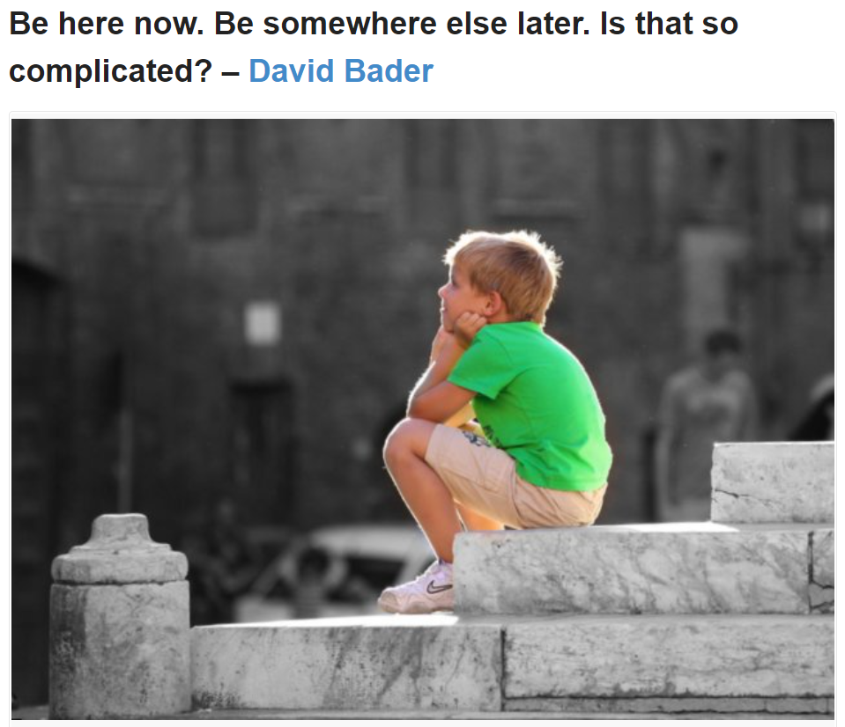
Bader, David M. (Harmony Books, 2002)...
M.
Bader, David M. (Harmony Books, 2002) Zen Judaism – For You, A Little Enlightenment
David M. Bader is a writer in New York City, a pursuit that raises the eternal question, "From this he makes a living?" He is not even distantly related to Supreme Court Justice Ruth Bader Ginsberg, though he insists on referring to her as "Aunt Ruth.“- Thenile: 9780609605028
Philosiblog: Be Here Now Be Somewhere Else Later Is That So Complicated

Slide 4
Outline
Hello and Welcome!
Goals and Objective
  Learning intro to Computer Science by hands-on programming
  What is a computer?
  What is ‘programming’? How to ‘program’ a computer?
    “Programming .. is a set of instructions that tells the computer what to do.” [p.5, of the Alice2 textbook]
Syllabus Review
Alice2 Tutorial
Unless otherwise noted, the sources of images in the course slide deck are from Commons.Wikimedia.org

Slide 5
Hello and Welcome! (1 of 4)
Health Protocol
MCCC Campus Safety Protocols for in-person classes,
Mask-on, Nose-covered, keep distance
Show instructor MCCC Symptom Tracing card, if applicable
Wipe-down at the start and end of class
IT help: Mitts@mercer.edu
BlackBoard help: Mercer Online: Mccc Web Resource
Can also login through MyMercer: Mercer County Community College Portal
Learning Center Web Site:
MCCC Tutoring Services
UNC Learning Center Resource
Watch (DIY) “I worried about my grade” video: YouTube Video
Unless otherwise noted, the sources of images in the course slide deck are from Commons.Wikimedia.org

Slide 6
Hello and Welcome! (2 of 4)
YouTube Video The Other Pair” [3:55]
Think Win-Win!
“7 Habits of Highly Effective People,” Stephen Covey
(Habit #4)
YouTube Video [6:12]

Slide 7
Hello and Welcome! (3 of 4)
  Read Below & Count the Number of F’s.
FINISHED FILES ARE THE RESULT OF YEARS OF SCIENTIFIC STUDY COMBINED WITH THE EXPERIENCE OF MANY YEARS.

Slide 8
Hello and Welcome! (4 of 4)
  Read Below & Count the Number of F’s.
FINISHED FILES ARE THE RESULT OF YEARS OF SCIENTIFIC STUDY COMBINED WITH THE EXPERIENCE OF MANY YEARS.
Programmer needs
Focus and Attention to Details

Slide 9
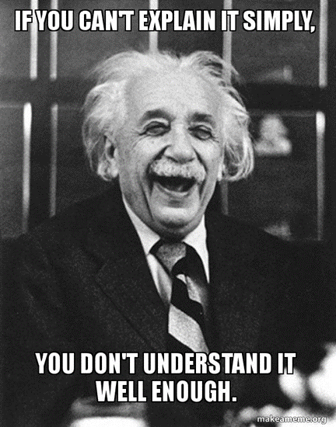
With an End Goal in Mind & …
YouTube Video [5:49, 081721] Inside the lab: How does Atlas work?
YouTube Video [9:46, 011823] Inside the Lab: Taking Atlas From Sim to Scaffold
YouTube Video Tesla Bot Is OFFICIALLY Ahead Of Boston Dynamics! [8:53, 061323]
You be the judge…
Tesla Official Site
Interesting Engineering Article [1:18, 092323]
Reddit Discussion - Boston Dynamics, Spot
YouTube Video Getting a Leg up with End-to-end Neural Networks | Boston Dynamics [082025]
YouTube Video How does Atlas learn? [051826]
YouTube Video Robotica
In any case, think critically and …
Ytlarge: Video Data Viewer - to find out ytube upload date

Slide 10
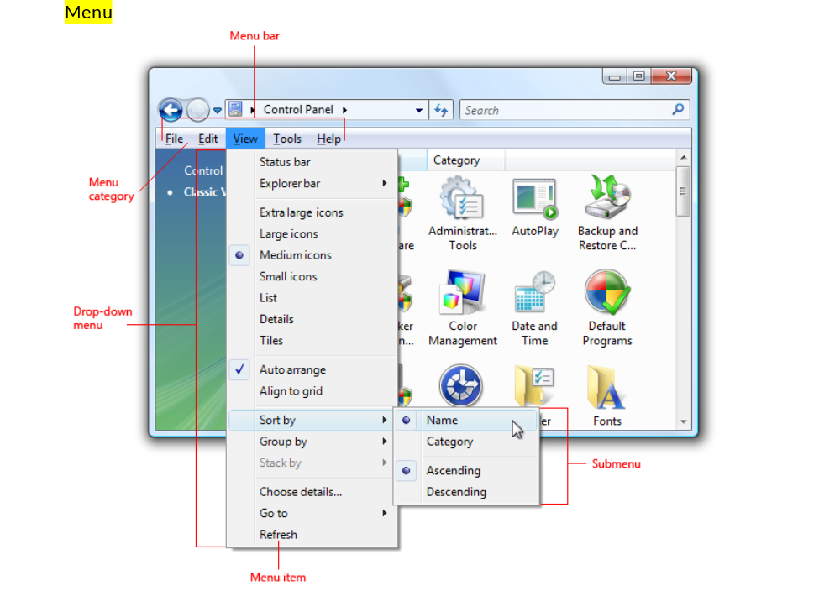
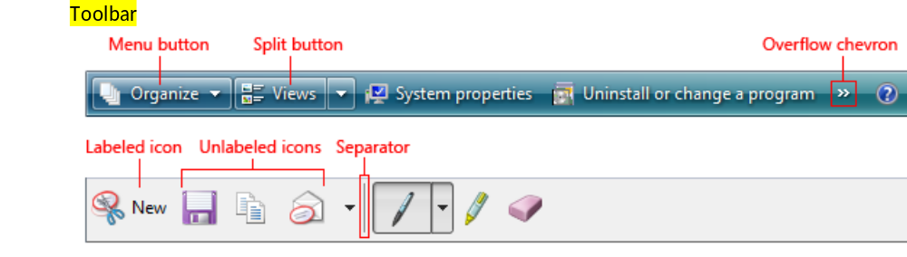
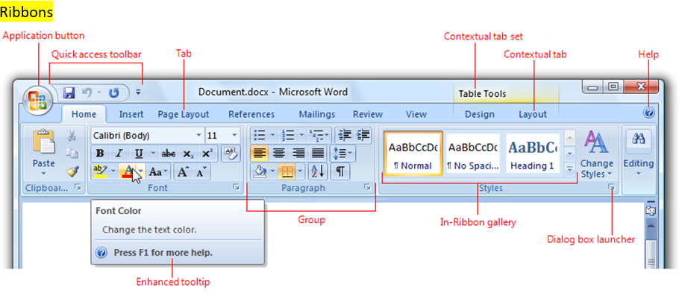
About Computer Screens

Slide 11
The Syllabus A Must Read Incl....
The Syllabus
A Must Read
Incl. Semester @ a Glance (topics & assignments)
Importance of Terms, Definitions, & Concepts (TDC)
Test #1 and #2: one cheat sheet, double-sided allowed (standard letter size, 8.5”x11”)
Term Project Presentation: a game implemented in Alice2 that meets requirements s.a. # of created methods, functions, events, etc.

Slide 12
Getting Started
Text Book: Learning to Program in Alice, 3rd Edition
Get familiar with the textbook design: chapter headings (Contents), Index/indices, front & back cover (has special cross-references), color fonts, Tips & Techniques, Summary, Concepts, Programming Terms, Animation Terms, Questions, Exercises, etc.
Blue/green font indicates a new term.
Cross-reference between the chapters (concepts) and Appendix (software tool tutorial and usage examples).
In Appendix, red fonts and circles tell you where to look in the Alice tool screen panel(s).
Google term, vocabulary, that are new to you, record in your cheat sheet (Terms & Definition, and Concept (TDC)) doc; think of TDC as your personal ‘dictionary.’
You can search for more ‘technical’ definitions of terms in PCMag Encyclopedia
Tool (Software): Alice-2 → See special Hardware and setup related notes in Bb>Course Info.
Resources and References, etc.
alice.org > Resources
Www2: Aliceglossary Pdf
Www2: Chapter1Vocab Key Pdf

Slide 13
Best Current Practice (BCP) (1 of 2)
➔Build good habits from the get-go and follow through consistently →Remember in the industry, someone (teammates or colleagues) may need to continue your work…
Naming Convention, meaningful, succinct names, for variables
  Camel case or Pascal Case
  Example: “My first animation file” → MyFirstAnimationFile
Organization
  Folder/directory tree →Appx-A suggests creating a AliceWorlds folder
    Create sub-folders for each assignment chapter for ease of search

Slide 14
A “Tree”
This PC
Documents
COS101
Alice2
Computer
Concept
HW
Ch1
Ch2
An example File Structure – like an up-side down ‘tree” with a root, branches, and leaves

Slide 15
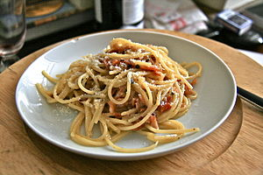
Best Current Practice (BCP) (2 of 2)
➔Build good habits from the get-go and follow through consistently →Remember in the industry, someone (teammates or colleagues) will need to continue your work…
Naming Convention, meaningful, succinct names
  Camel case or Pascal Case
  Example: “My first animation file” → MyFirstAnimationFile
Organization
  Folder/directory tree →Appx-A suggests creating a AliceWorlds folder
    Create sub-folders for each assignment chapter for ease of search
Coding & Testing (Programming)
  Logic: Easy to understand and elegant; no spaghetti code
  Readability, Maintainability: Indentation (automatically done in Alices), etc.
  Documentation: Effective, succinct, meaningful comments (in code) for another human to read & understand your code, and continue the project
  Last but no the least, code and test in increments
    Code→test→code→test→repeat.
    Expect to make mistakes, to debug until you get it right! “To Err is Human.”

Slide 16


Java/C++ → C# Quora Discussion
Java/C++ → C# Quora Discussion

Slide 17
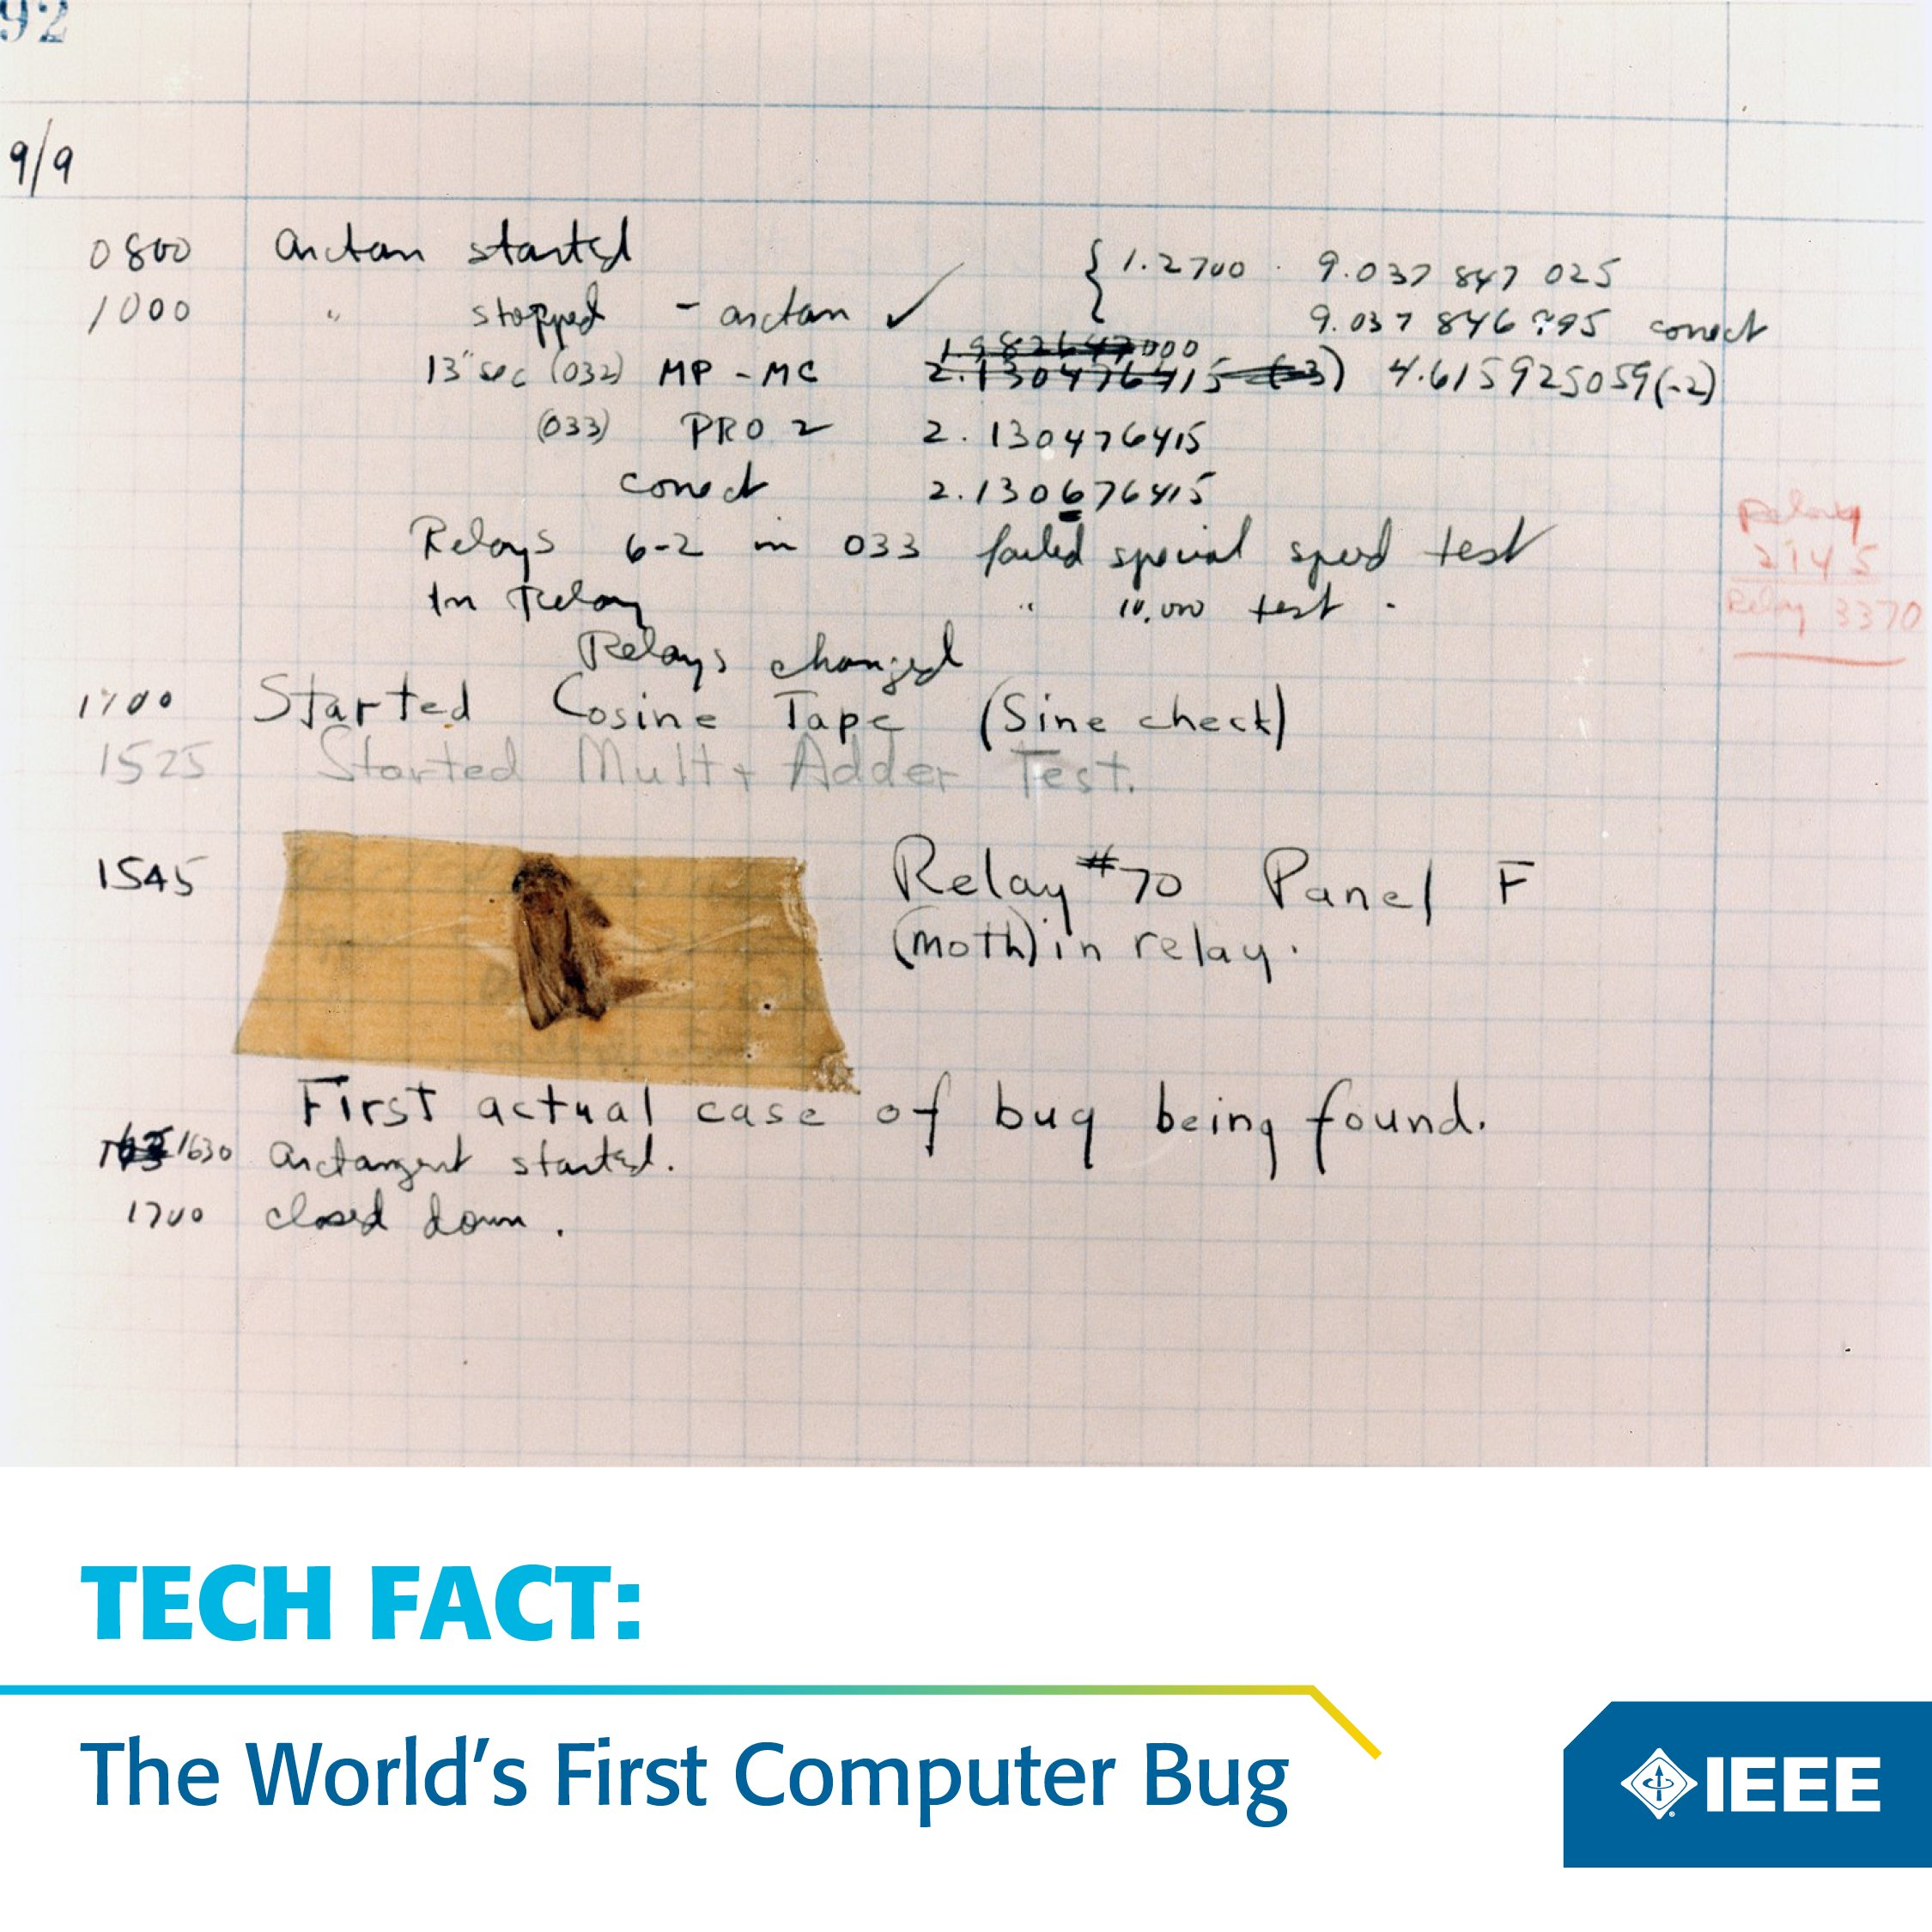
A “bug” is an error, fault or flaw in a code, a program.
So, must ‘debug’ it
“Bug” and “Debug”
Bug found on 12/09/1947, 3:45p

Slide 18
Introduction to Alice
Chapter
1
Alice is named in honor of Lewis Carroll’s “Alice in Wonderland”
A “modern” programming tool
3-D graphics
3-D models of objects
What is an object wrt programming?
Animation
Objects can be made to move around in the virtual World (a video game or simulation implemented in 3-D)
Use the software download (version 2.6 or the latest) from the web Alice 2 Download Page or on the CD from the book (version 2.2)
Download and Install Alice-2
Follow the download instructions posted on Bb, depending on your Operation System (Windows or Mac)
Mac & Chromebook ‘tips’?
  If you have a recently updated Mac, Alice2 will NOT work. Use classroom machine or BS102 Windows machine. Email work to yourself or save it on USB stick. When using machines in BS102, search for Alice2 @ lower left.
Notes:
Carnegie Mellon University
Alice 2.5 works for the newest MacOS (version 10.13) now as of the end of Spring 2018.
18

Slide 19
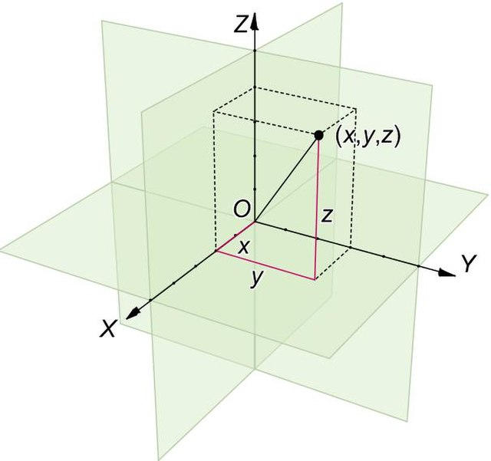
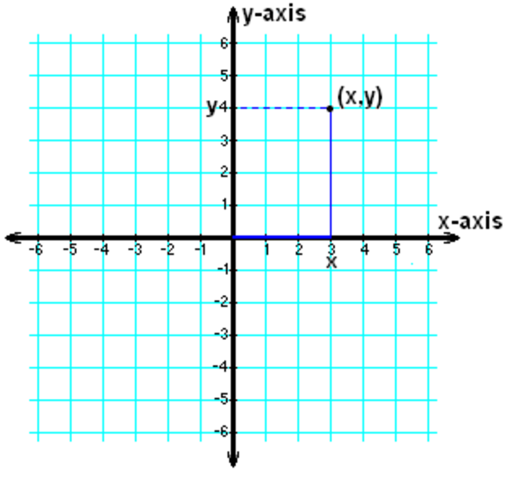
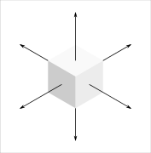
2D vs. 3D
* 2D * 3D

Slide 20
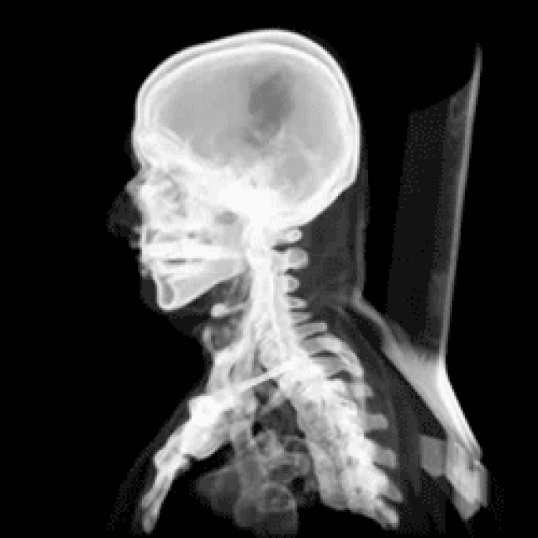

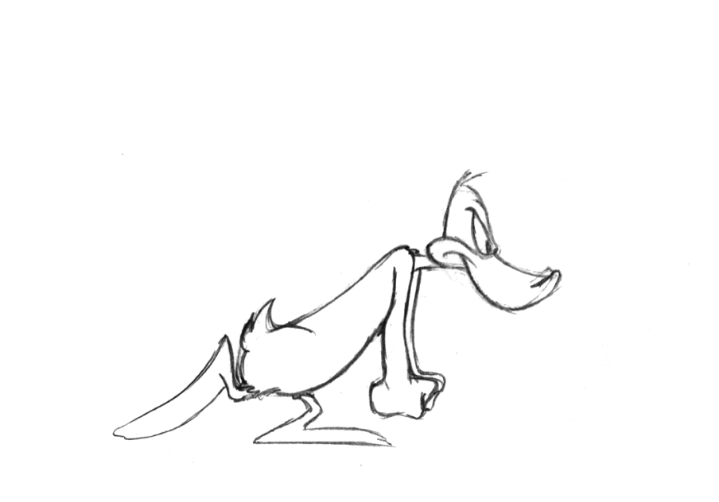
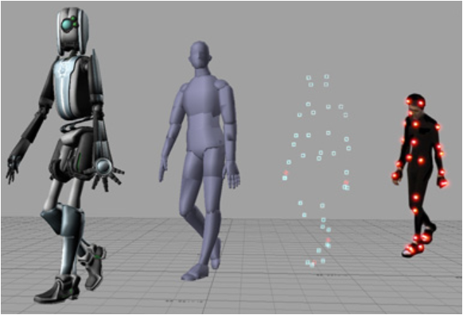
2D vs. 3D with Animation
* 2D * 3D
  Wikimedia Commons Resource
Wikimedia Commons Resource
Pinterest: 145804106670910411
Wikipedia Article – Motion Capture Technique

Slide 21
Csai Web Resource
Muscle: you can rotate the object
Today: 3D Animation & Interaction for Web and VR

Slide 22
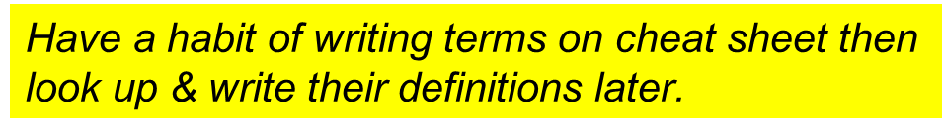
Course Outline (2 of 2)
Chapter 1 Getting Started with Alice ⬅
Chapter 2 Program Design & Implementation
Chapter 4 Classes, Objects, Methods and Parameter
Chapter 5 Interaction: Events and Event Handling
Chapter 6 Functions and If/Else Control Statement
Chapter 7 Repetition: Deterministic and Conditional Loops
Test #1
Computer Concepts
Test#2
MATLAB
Project Presentation

Slide 23
Learning Order
Read Chapter 1, pp. 3-9
DIY (self-paced) Alice tutorial (Appx-A)
Then read the entire Chapter 1
Jot down TDC along, incl pg #, in cheat sheet
Except for assignments to submit, feel free to discuss with a partner.
  Q: Does Bb have classmate roster sheet?
  A: You can see a list of your classmates when you try to send email to all.

Slide 24

Getting Started (Part 1 )
Appendix
A
Download and install Alice tool (software)
- By now, you should have your Alice2 tool installed in your machine.
Starting Alice
- double click the executable file, Alice.exe
- a shortcut can be created on desktop
Follow exact steps in self-paced tutorials in Appendix A
  - First, do a ‘trial run’ from Play-ing (running) two virtual worlds under textbook tab
  - AppendixA_FirstWorld (Figure A-1-5: “World 1”)
  - AppendixA_DancingBee (Figure A-1-8: “World 2”)
Kinds of Animations [p.143, 145]
- Passive: in movies, a user watches the animation; a user is the human using the tool, a client of which the tool you programmed for
- Interactive: User clicks on mouse, types a key on keyboard, etc. …
    Actions of a user are called events; events are triggered by users
    The responses to the events are called event handler
    Being interactive is aka (also known as) event-driven

Slide 25
World 1
P.333
AppendixA_FirstWorld (Figure A-1-5: “World 1”)
Learning Objectives
- How to start Alice
- How to open a saved world
- How to play a world
- How to stop a world
- How to restart a world

Slide 26
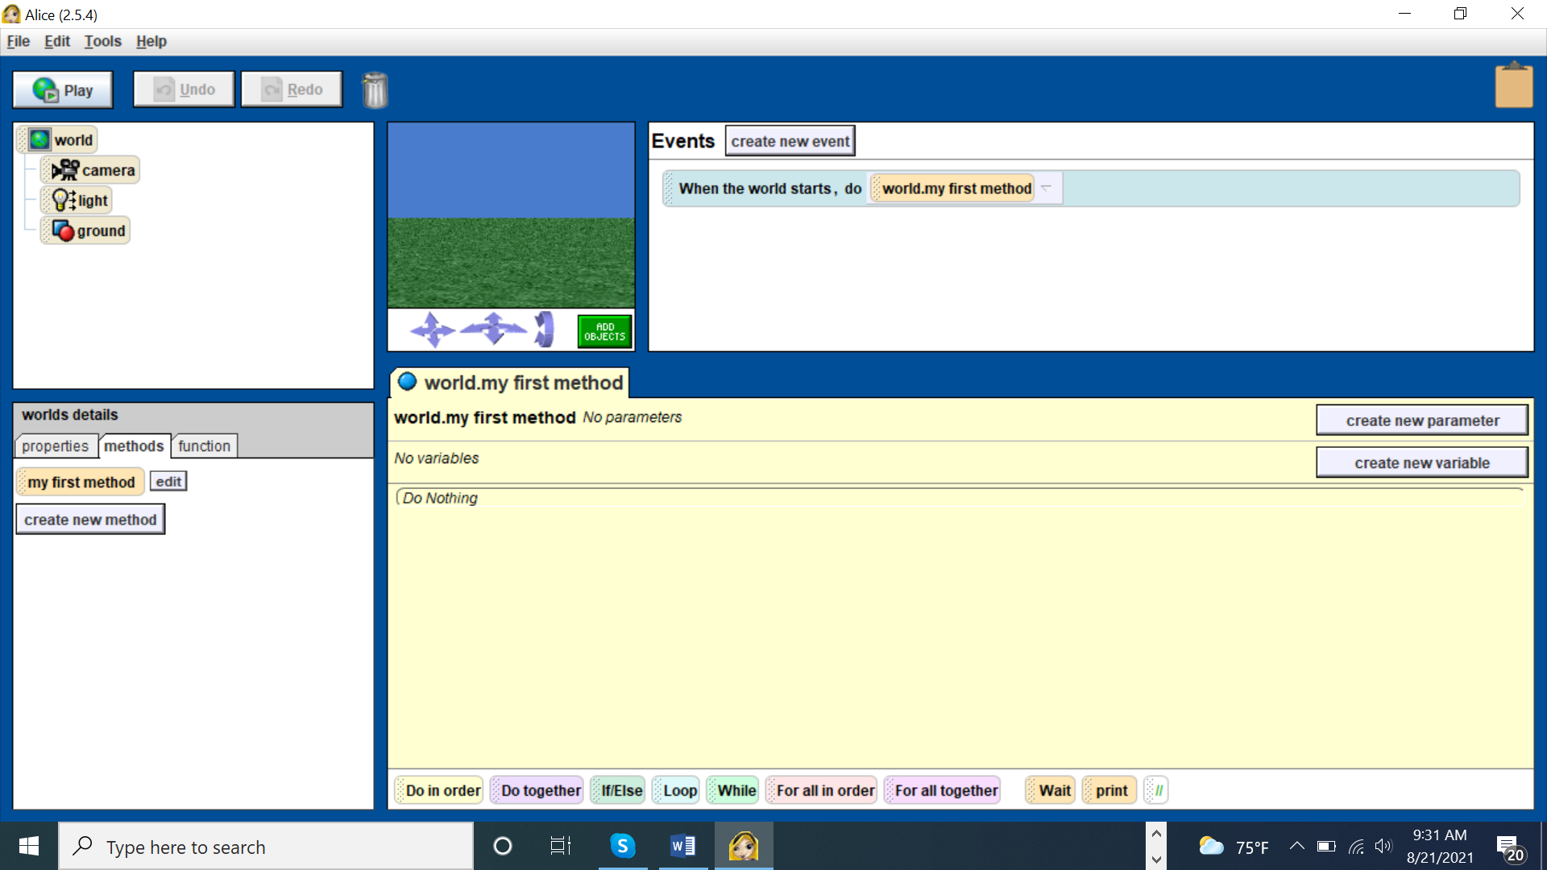
The Alice’s Tool-Human Interface
P. 332
Fig. A-1-3

Slide 27
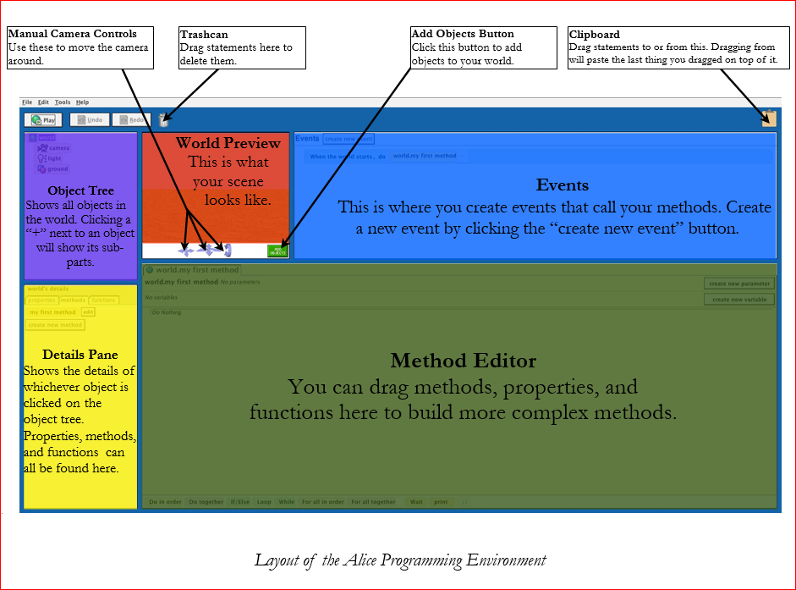
The Alice Interface
P.332
Fig. A-1-3
undo
Www2: Aliceglossary Pdf

Slide 28
World 2
P.334
Learning Objectives:
- How to start Alice
- How to open a saved world
- How to play a world
- How to stop a world
- How to restart a world
- AppendixA_DancingBee (Figure A-1-8: “World 2”)
Running interactive worlds w/ events and responses
    A program can be written to be event-driven
    In Alice2, an event can be triggered by user’s mouse click or keyboard entry ← We will learn this much later
World 1

Slide 29
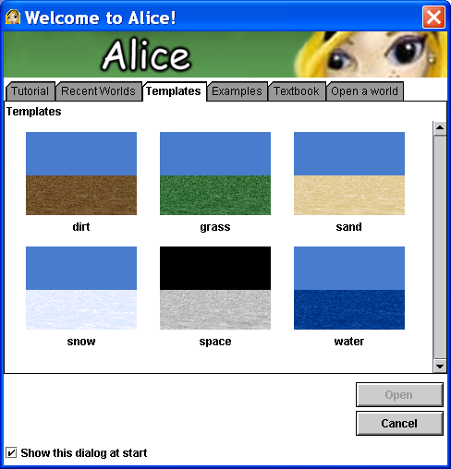
World 3: Create a New World
P.332
P.335
Create a new world
  File → New World
  Choose a Template for your world’s scene
  Default template is the grass
Notes:
Developed and maintained by Carnegie Mellon University
29

Slide 30
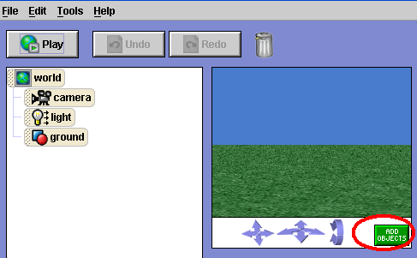
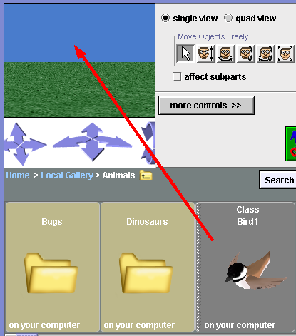
Demo: Add Objects
P.337
Scene Editor
Click ADD OBJECTS to add an object from Local Gallery, CD Gallery or Web Gallery.
Do Search to find what you want; drag & drop to the World.
Scene Editor allows you to edit the object.
Note: Class Bird1 only has one bird as an object. Put curser on its right and it will say it’s an object. Bugs folder has many objects (different bugs) that belong to the class, Bugs.

Slide 31
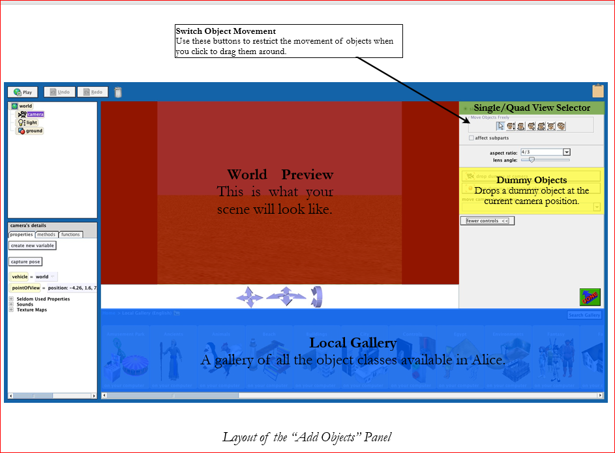
The Alice Interface – Add Object
Www2: Aliceglossary Pdf

Slide 32
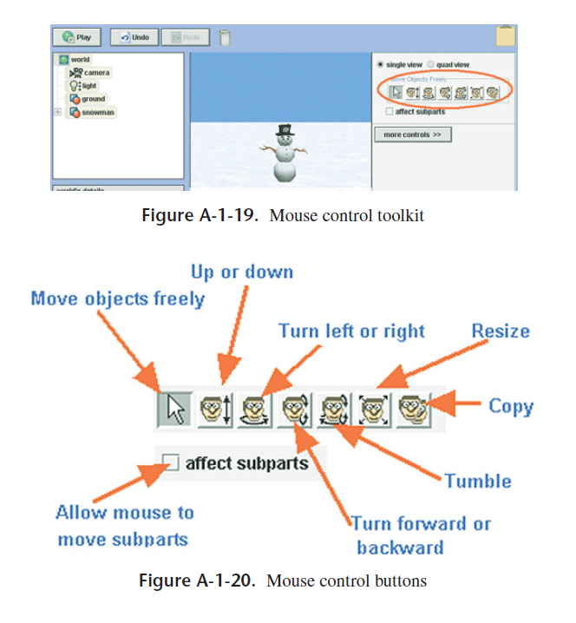
Topic Overview (Slide 32)

Slide 33
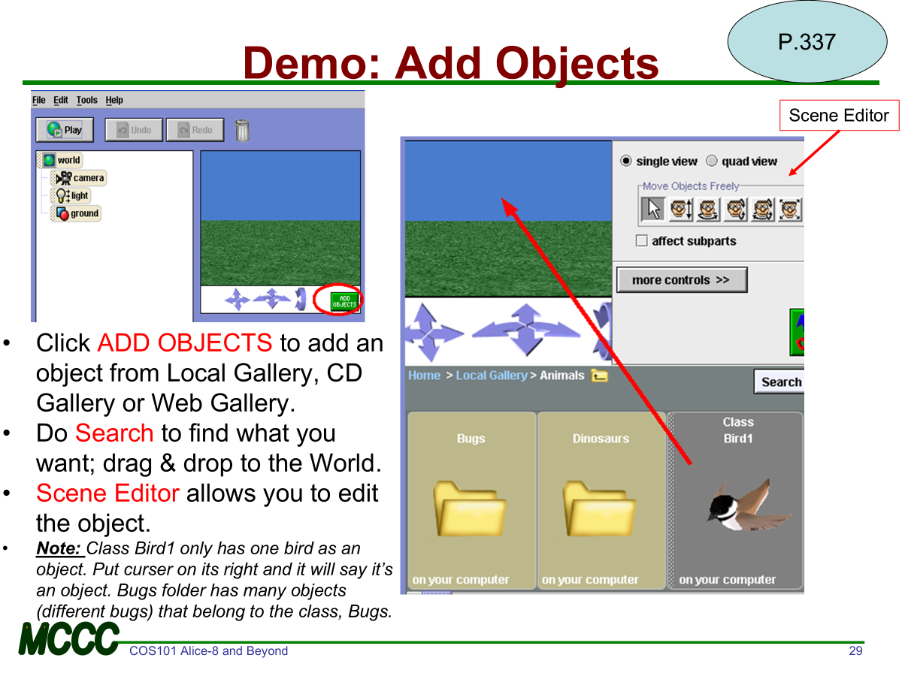
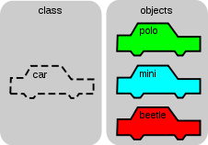
Class and Objects
Class and Objects
  which is the superset and which is the subset?
A Class:
What are example birds (objects)?

Slide 34
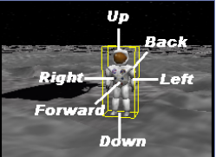
3D Object Dimensions
Chapter 1
pp. 10-11
A 3D object has
  3 dimensions
    height, width, depth
  6 degrees of freedom (directions of movement)
    ➔Direction is egocentric (p.45)
      ➔ The center is the object itself, not the viewer of the object.
  A mouse-click on an object in Alice, a yellow bounding box appears

Slide 35
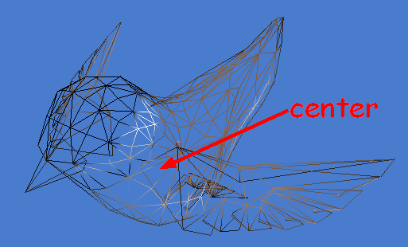
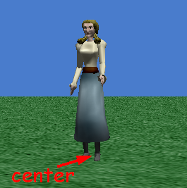
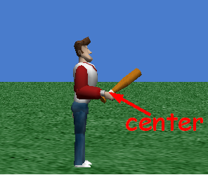
Center of an Object
Chapter 1
P. 12
  At the center of mass
  Where it stands on the ground
  Where it is held

Slide 36
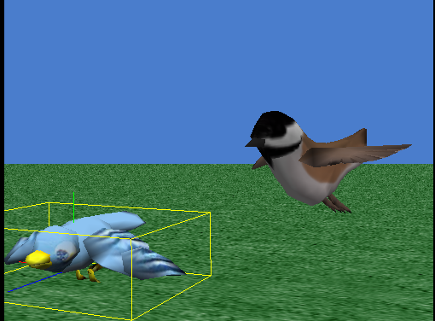
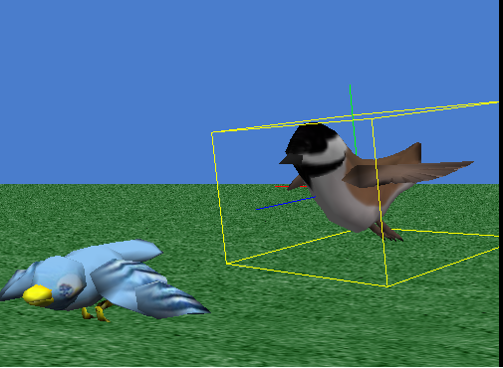
Know Thy Bonding Box

Slide 37
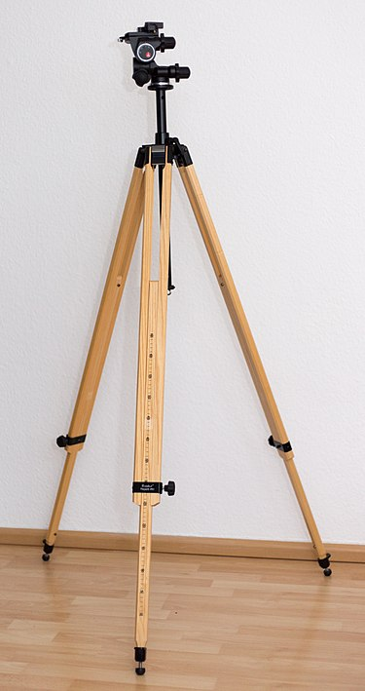
Techniques and Tools
Appendix
A
Arranging Objects in a Scene
Mouse is used to
  position objects in the scene, approximately
Quadview in Scene Editor is used to
  position one object relative to other object(s)
Camera Navigation is used to
  set the camera point of view
  Think of each camera as being on a tri-pod. One may use more than one cameras in a setting.
  DIY; try and see….

Slide 38

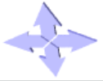


Camera Control/Navigation
Mentioned briefly in Ch.3 & App-A
Move camera up, down, left, right
Move forward (move near), backward (move away); Turn left, right (when stationary)
Tilt camera forward (look down) and backward (look up)

Slide 39
Getting Started (Part 2)
Using Popup Menu to Create an Initial Scene
Appendix A ,
P. 345
We have learned to use mouse control to arrange objects in a scene.
We will learn methods to work with an object in setting up a scene with more precision than mouse control.
A Method is a group of instructions
Alice provides many already built-in methods that can be used to adjust the size and position of objects, etc. to increase precision, and the resultant image can be more spiffy and sharper
Right-click on the object in the Object tree; click “method” and then choose the desired built-in method ...

Slide 40
Saving a World (file)
Appendix A ,
P. 335
Writing and testing an animation program is an intense load on the computing system – a program crash can occur.
File → Save World
  Save as where file name extension is *.a2w
    a2 for Alice2 and w for the World you just created.
      * is called a ‘wild card’ where you can substitute with a string. So, *.a2w essentially means any file name ending with .a2w.
    DIY: save it on desktop. Get out of Alice and get back on. Open to see and access the saved *.a2w.
Best Practice:
    save your world frequently after you made and tested a satisfied change (or after a certain period or as often that makes sense)
    also save to a backup system (for example, flash drive). Suggestion: Use a flash drive, cloud storage or email to self to save a backup of your work periodically if using school’s machine.

Slide 41
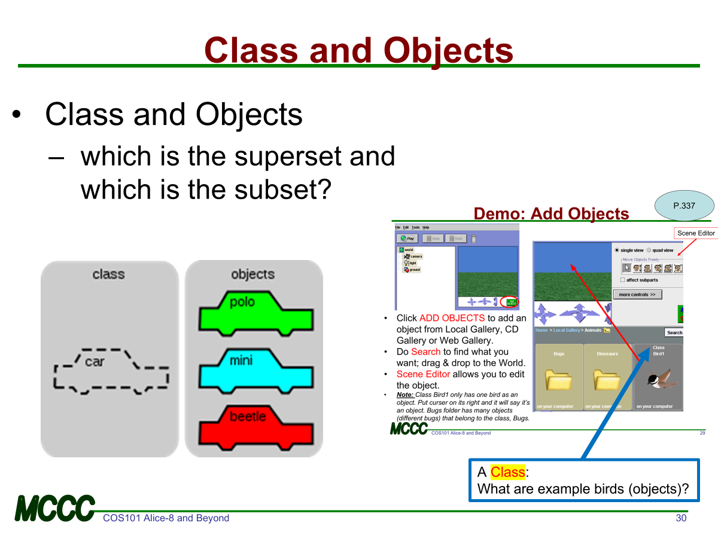
Topic Overview (Slide 41)

Slide 42
Terms & Concepts: Object vs. Class
Chapter 4
Pp. 89-90
Fig. 4-0-2
Objects are categorized into classes
Each object is an instance of the class. (p.338)
All objects in a class have
  similar properties and
  generally can perform the same tasks (methods)
Peter
Person
Paul
Mary
bunny1
bunny2
Bunny
bunny3

Slide 43
Object vs. Class
An "object" is
  anything that can be identified as unique from other things within a class.
How is an object unique?
  has a name
  has properties (attributes):
    width, height, color, location
  can perform actions (methods):
    associated actions it can perform
    tasks it can carry out

Slide 44
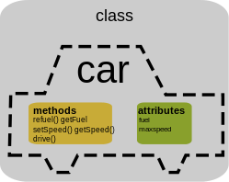


Methods and Properties (Attributes)
Methods
Properties/
Attributes

Slide 45
Object-Oriented Programming: Class and Objects
In Object-Oriented Programming
A Class is a blue-print or template that defines objects, attributes (properties), and methods (actions, behaviors) that belong to the class itself. – think of a class as a defined group.
An object within a class is, thus, a specific instance of the given class.

Slide 46
Terms, Definitions, Concepts
class
object
properties (attributes)
methods
instance
user
tree
interactive, event driven (p334)
world
scene, scene editor (p.337)
Add objects (p.337)
object tree
object details
properties (attributes)
methods, methods editor
mouse control buttons (A-1-20)
camera control (A-1-30)
single view, quad view
Subparts (A-1-21)
events
bounding box
Center of an object
Tool kit of buttons (p.339)
Search Gallery (p.337)
Undo (A-1-18)

Slide 47
Summary
Get Started with Alice
How to start Alice
How to open a saved world
How to play and stop a world
Running interactive worlds w/ events and responses
How to create a new world and save a world
How to add objects to a world
Objects vs. Classes
How to arrange the objects in a scene
Using popup menus to create an initial scene
  ➔mouse control vs. methods (where methods gives more precision)
No Animation yet – will learn to create animation from Chapter 2 on

Slide 48
Practice Test
Define a class and an object, given an example
Define a “Tree,’ given an example how it is used.
Define 6-degree of freedom
Draw and name panels in Alice2 tool graphical user interface (GUI) and give as much detail and descriptions of each panel’s purposes.
Where are Single View, Quad View in Alice GUI and what are they for?

Slide 49
Labs & Assignments
P.338
P.19
Exercises
Appendix A: Getting Started Part I
Revisit FirstWorld and Dancing Bee, two already written programs (worlds), poke around, make changes and see the effect
  What differences do you see between the two programs?
Homework
Exercise 1.1: Island World
Exercise 1.2: Winter
Exercise 1.3: Snowpeople Pile
Demo completed Alice work to instructor in class to mark work completion.
Upload *.a2w files to Bb to get a Bb score.
  Multiple submissions allowed, upload work-in-progress at end of the lab; only final submission will be scored.
  Filename containing your initial and Exercise# so instructor knows it is yours and which assignment it is.
Read Ch2 ahead

Slide 50
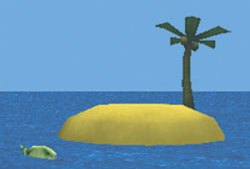
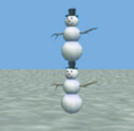
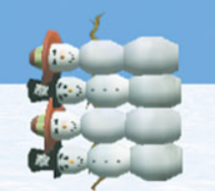
HW Description
1. Island
Create an island scene. Start by choosing a water world template. Add an island
object (from the Environments gallery folder). Use the scene editor to position the
island a bit to the right of the center of the scene. Now, add a fish (from the Ocean
gallery) to the scene. You may find that the fish is invisible because it is located
behind the island or is not properly positioned. Use the scene editor and its quad view
to arrange the fish so it looks like it is swimming in the water to the left of the island.
Use the camera controls to zoom out so the island and the fish are both in the camera’s
view.
2. Winter
Add two snowmen (People gallery folder) to a snowy scene. Use a snow template initial
world. Then, create a snowman stack by using the scene editor’s quad view to position
one snowman on top of the other (vertically), as shown below.
3. Snowpeople Pile
Build a “wall” of four snowpeople by tipping them over on their sides and piling them
on top of one another. (Use methods, mouse controls, and quad view.) Four snowpeople
(alternating between snowman and snowwoman) might be used to produce a wall that
looks like this. Hint: right click on an object for a quick methods access.)

Slide 51
Alice2 Usage Tips
File>New World to “Welcome to Alice!”
“Welcome to Alice!”>Open a World tab has your recent folder
“Welcome to Alice!”>Textbook has the two examples.
Click an (existing) object to get yellow bounding box, click Add Object, to get single/quad view to edit. Click DONE to return to World
To enlarge, shrink an object: click the object→Add Object→click single view/resize→press mouse-left button, move up (enlarge), move down (shrink). In Quadview’s magnifying glass, mouse to right to enlarge, left to shrink.
Changing color, etc. is to be done with an object’s properties.
A right click on an object, popup-menu||methods has list of avail methods (actions) and properties, a superset of the methods and properties that you can apply to the object.
When you save, click on pull-down in the save box to get to the folder where you want to store all your Alice related files. It’s important to have an effective file/folder/directory structure to store like-kind files so you (human) can find/search for them later.
  Your machine may save your file in a desktop. If so, move it to designated folder.
Do not use illegal characters in file names such as /\:*?”<>. Alice will say you do not have enough storage instead of illegal file name, which can be very confusing.
If your *.a2w is auto saved as *.pdf in your machine, if on Windows, do “rename” to change .pdf to .a2w. If on Mac, see slide below on “Mac: Changing File Name Extension.”
This PC
Documents
COS101
Alice
Computer
Concept
HW
Ch1
Ch2
An example File Structure –
like a ‘tree” with a root, branches, and leaves

Slide 52
“Flip Class” Topic Research and Discuss...
“Flip Class” Topic
Research and Discuss in Next Class

Slide 53
Points to Ponder
YouTube Video
The Top 1% Think on Paper. Here's How To Do It. [10:56]
YouTube Video 5 Rules of The Top 1% That Changed My Life [17:36]
LinkedIn Profile
YouTube Video Steve Jobs on the Truth of Life [00:55]
YouTube Video Life is Short (How to Spend It Wisely) [16:51]
YouTube Video
Empathy: The Human Connection to Patient Care [4:23]

Slide 54

Notebooklm Web Resource
Microsoft Co-Pilot
Study Assistants

Slide 55
Supplemental Slides
Supplemental Slides

Slide 56
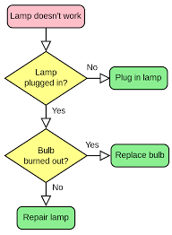
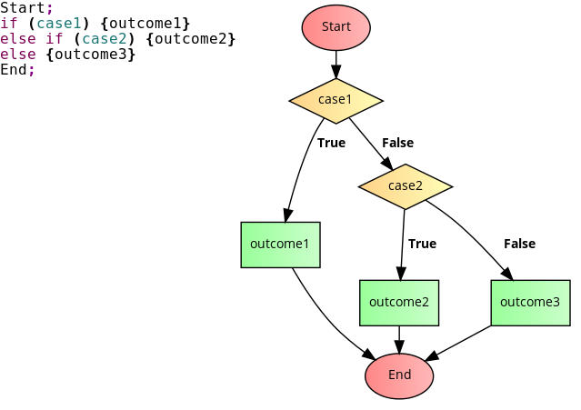
Terms: Flow Chart
Pp. 6-7
Fig. 1-1-2, 1-1-4
A Flow Chart is a diagram of a set of processes (See next slide re process)
  Depicts a flow of events to solve a problem, describe a problem, etc.
  Has sequences and combinations of sequences
  Uses commonly recognized symbols (Fig 1-1-2) when drawing a flow chart
    Use a diamond for decision making with True or False outcome
    Human use logic (yes, no), the so-called Boolean Logic (not, and, or) to determine Truth or False of an expression (situation)
Stepwise Refinement (work breakdown) is a decomposition of a solution space into pieces of sub-solutions and sub-processes.
Draw Flow Chart for
if-else Scenarios

Slide 57
Terms: Process
Pp. 6-7
Fig. 1-1-2
?
Inputs →
→ Outputs
  Simply stated, a “process” is a box with inputs and outputs.

Slide 58
If New to Your PC…
If New to Your PC…

Slide 59
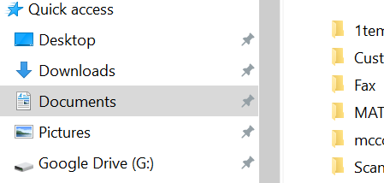

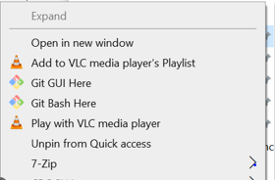
How to Pin and Unpin a Folder
Pinning a folder under Quick access heading gives you, well, a quick access
In the example on upper right, if you want to pin the folder named MAT, right click on the folder to get a menu item list, then click Pin to Quick access option.
To unpin, right click on the target folder under Quick access to get the menu item list. Then click on Unpin from Quick access option.

Slide 60
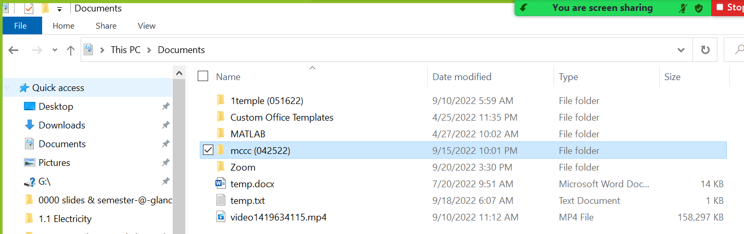
Windows PC File Management
I strongly suggest you use your Window’s Documents folder to create a file structure of parent folder/children folders, etc. The structure can have a mccc folder and each of your class in its own sub-folders.
Below is a sample file structure under This PC>Documents

Slide 61
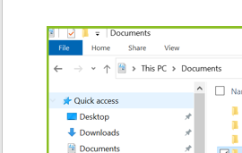
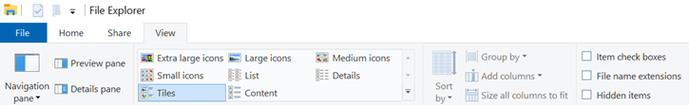
Windows: File Name Extension
Then click “view” (4th option on upper left).
Click “Details”
Click “File name extensions” so you can see the last 3 characters that show the file type.

Slide 62
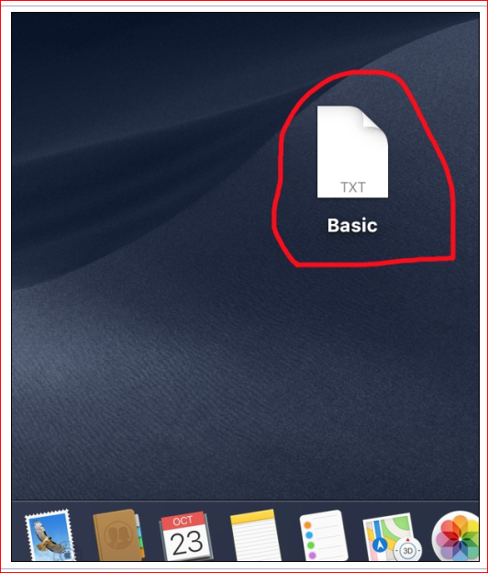
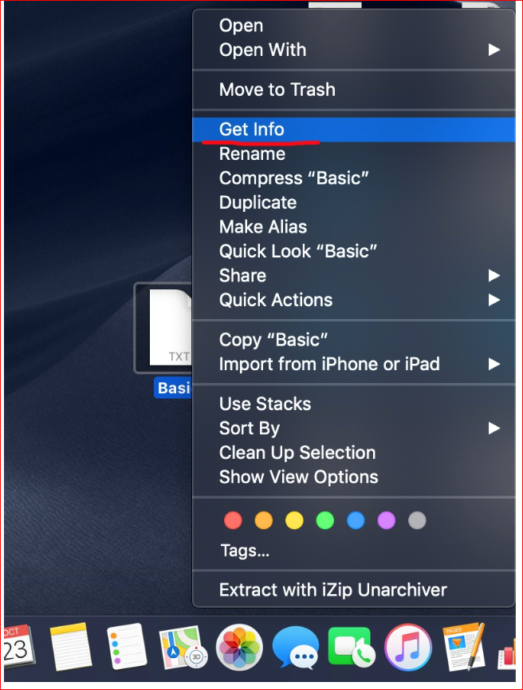
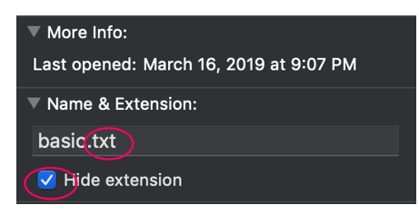
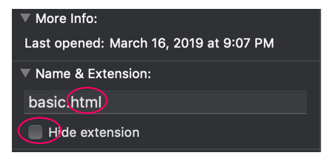
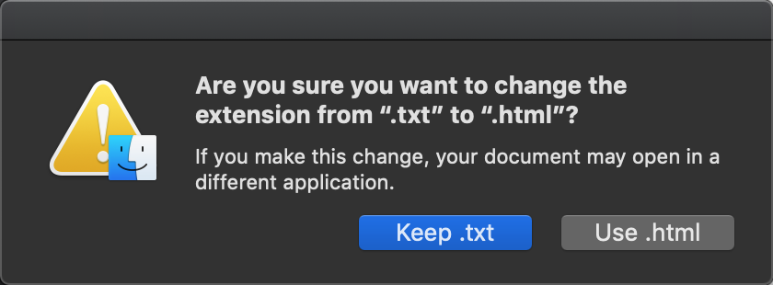
Ex of changing .txt file extension to .html
Mac: Changing File Name Extension
Two fingers on file (touch force feature) ➔
➔
➔
Unclick High extension

Slide 63
Concepts: Tree
Wikimedia Commons Resource search for below in the order given
tree
tree diagram
family tree
software algorithm tree
Using a ‘tree’ to visualize levels of “abstraction,” from real-life to its information representation

Slide 64
We Did It, So Can You!
Mercer County Community College Experience Readout
What
  VRS+AI Based Training Content Creation on Advanced Device Packaging (ADP)
How
  2+4yr Institution, Bi-Coastal Collaboration
  Interdisciplinary R&D Team, incl game developers
  End-to-End: Domain knowledge, demo capture→3D asset creation → Story Board → Animation & Interaction → AI Prompt & Agent(s) → Real-Time 360⁰ Learning Outcome Feedback
  6 CC students with full course load, in 6 months.
Next?
  Join us to build US national competency in VRS training content creation
  Open-source 3D model assets, Unity/SimInsight re-usable modules, AI-Vision capabilities

